Slide 1
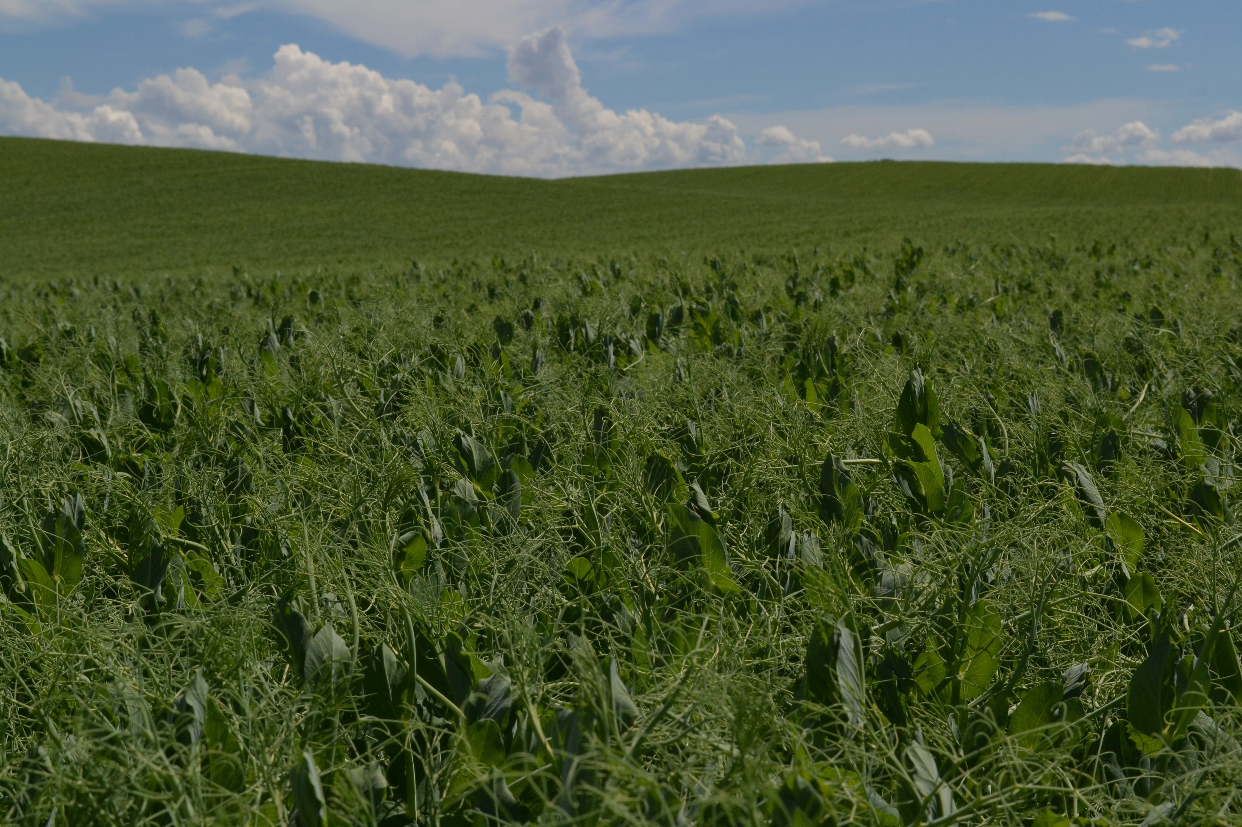

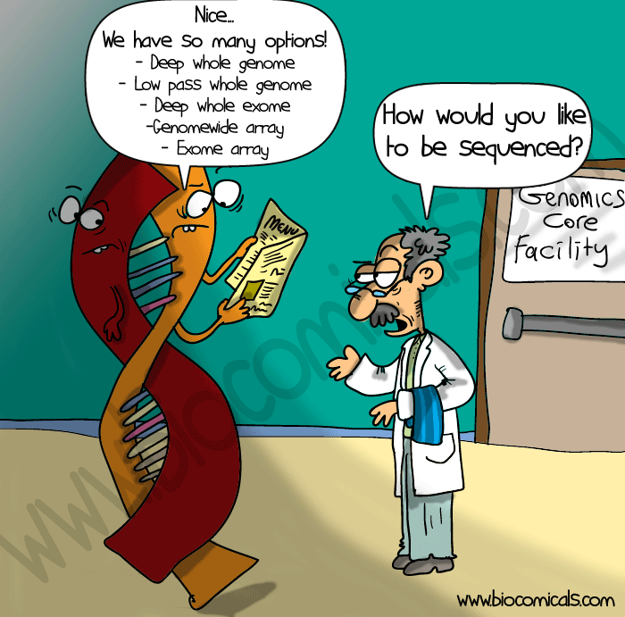
QTL Mapping by Jamin Smitchger (Mendel the 3rd)

Slide 2
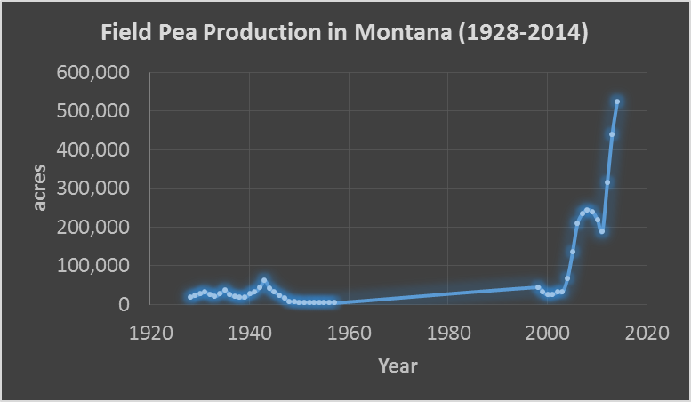
Pea production has increased by a factor of 25 since the year 2000.
Montana is #1 in dry pea production.
Approximately, 580,000 acres of peas were grown in Montana in 2016.
Farmgate value 100 million dollars
This data was shamelessly stolen from the National Agricultural Statistics Service

Slide 3
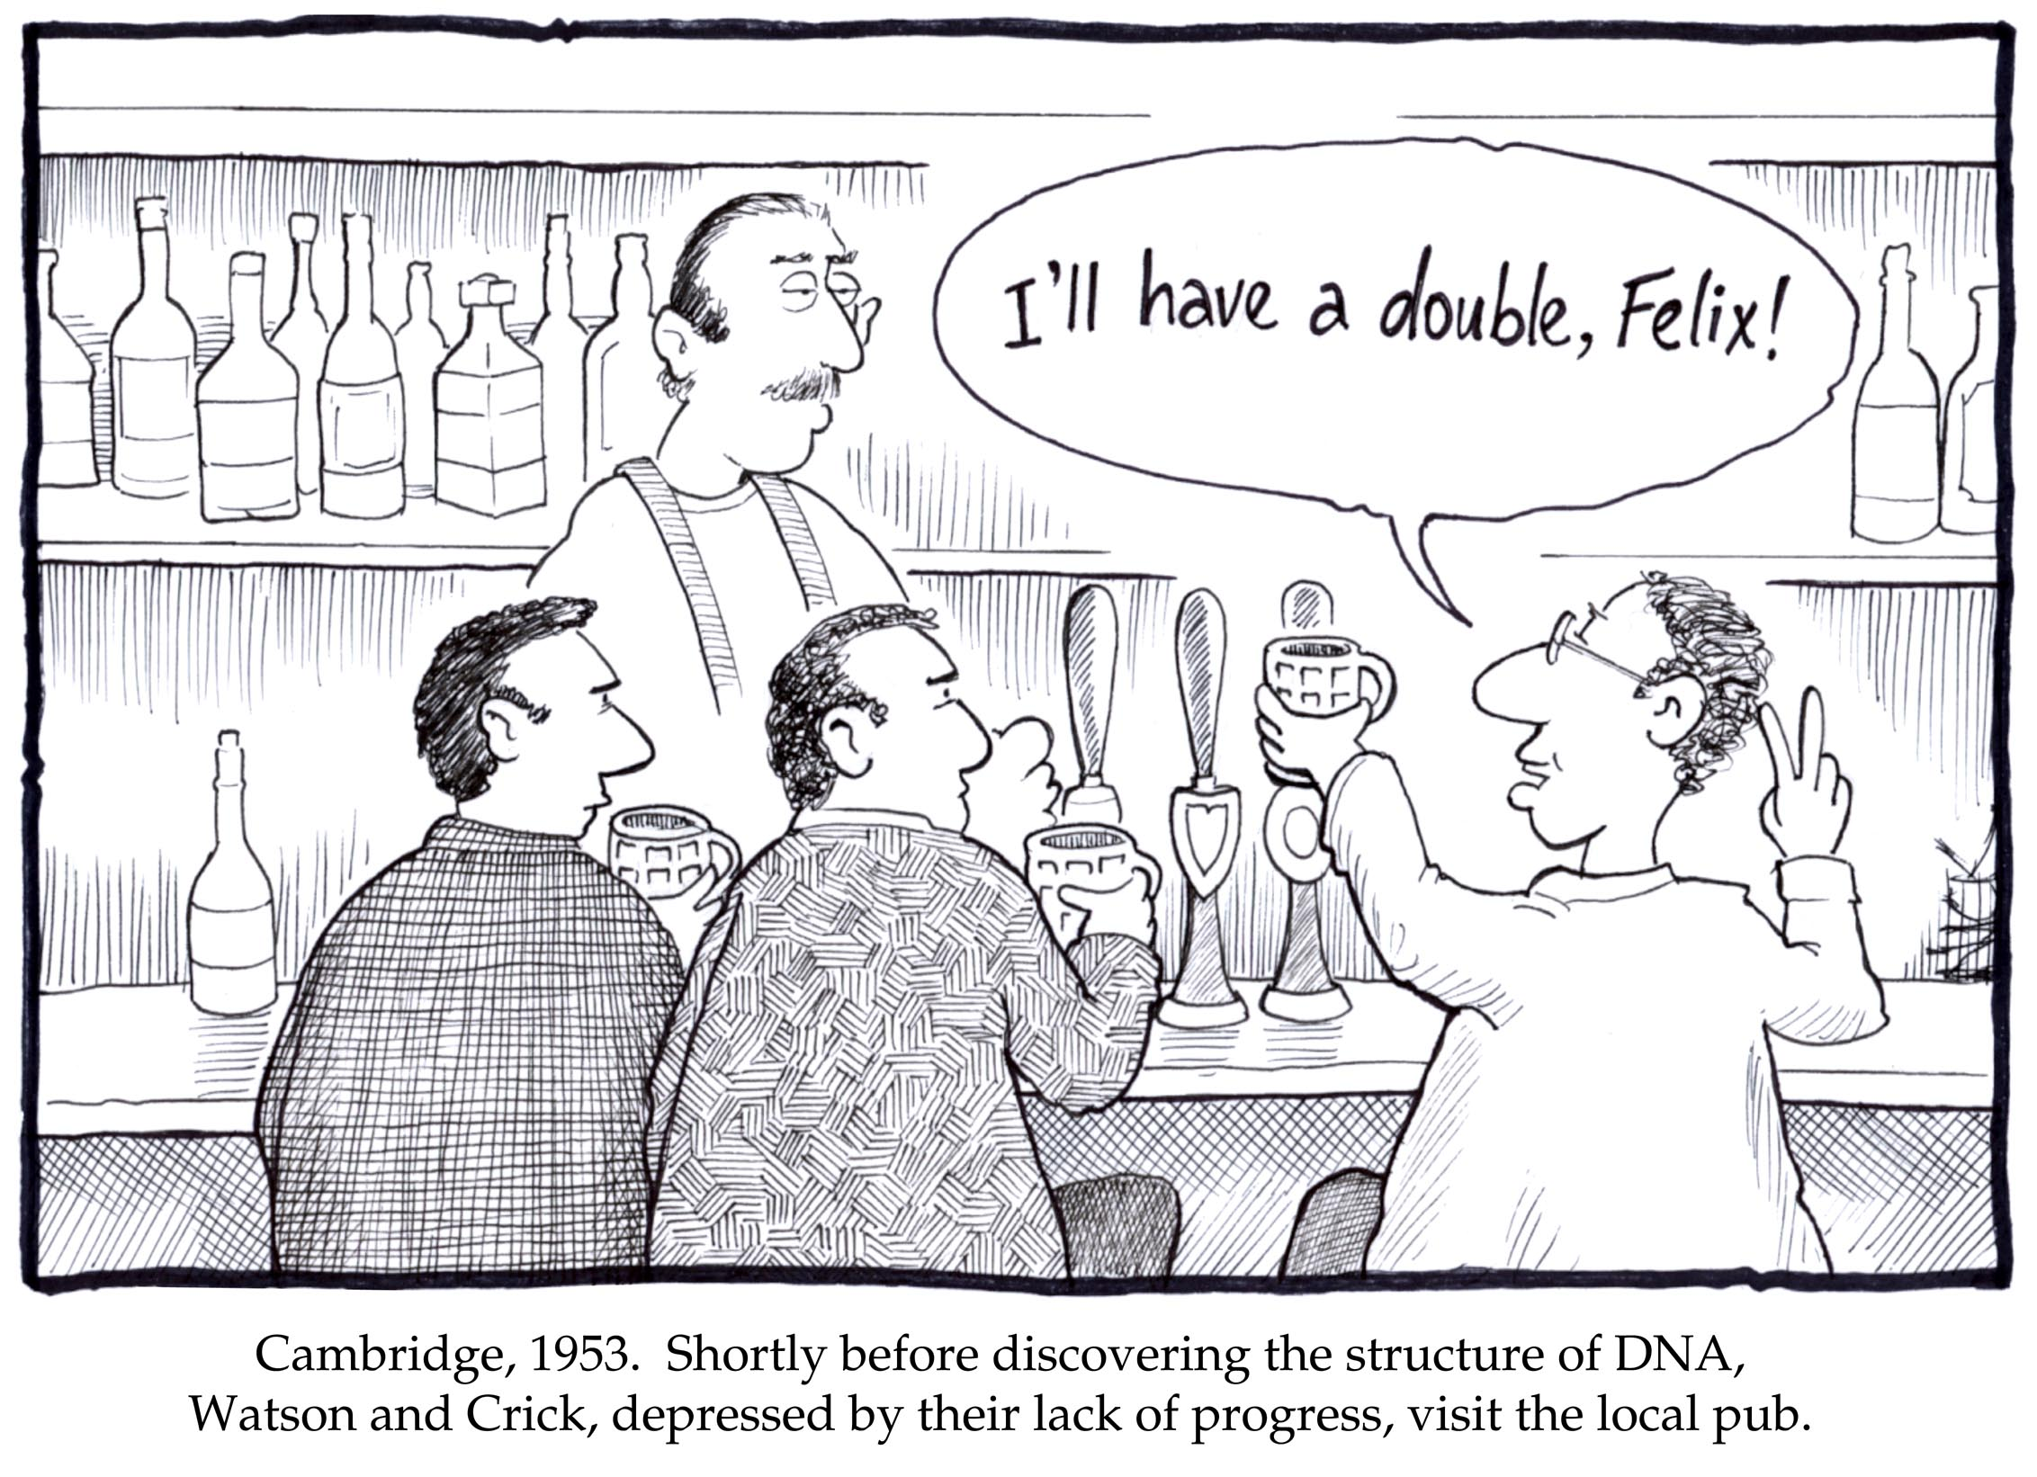
Let’s All Start Off with the Basics
The DNA sequence determines characteristics.
A gene is the blueprint for a protein which gives an organism a specific trait.
Genes are located on Chromosomes, which are huge blocks of genetic material, often containing thousands of genes.

Slide 4
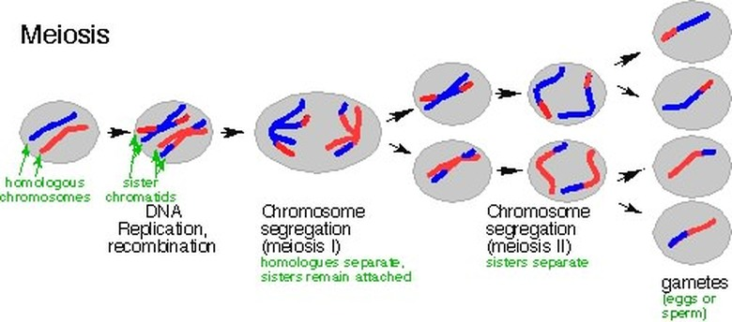
Meiosis

Slide 5
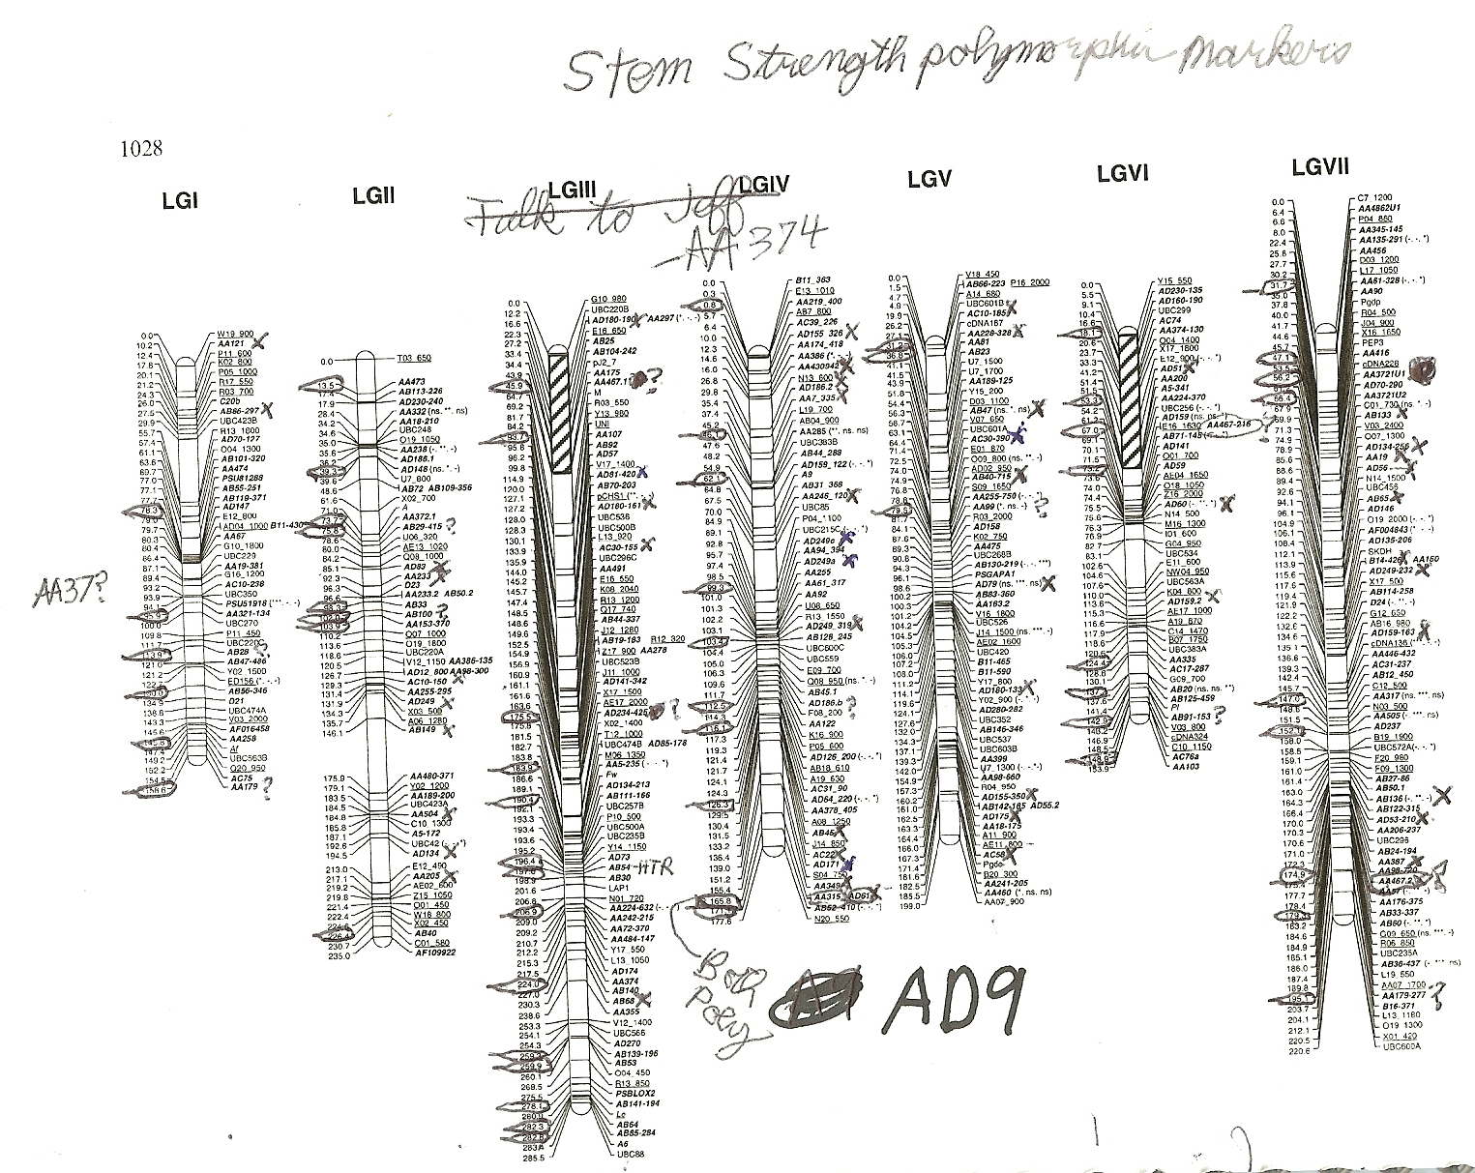

Slide 6
The Inheritance Pattern of Genes Tells Us Where Genes are Located
Genes located close together on the same chromosome are more likely to be inherited together. This is called linkage
So we analyze the inheritance pattern of genes in hundreds of progeny of a hybridization.
Each parent likely contributes a different DNA sequence to its progeny.
We map the location of genes based on other genes in order to create a map of genes in relation to each other.

Slide 7
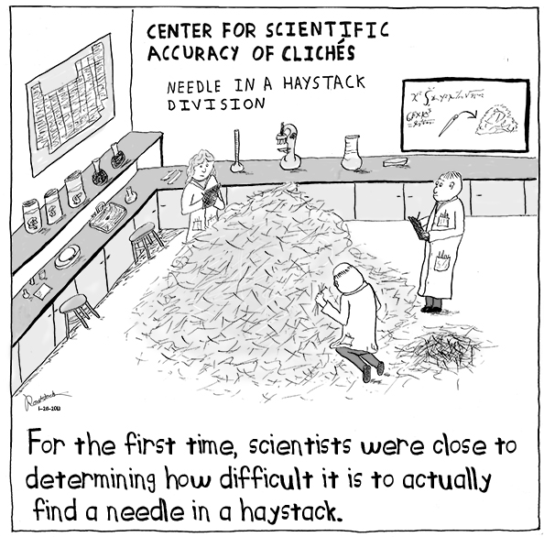
Finding the Proverbial Needle (gene) in the Haystack
A Genetic marker is a difference in DNA Sequence.
Genetic markers tell you whether you are close to a gene causing a trait because they have the same inheritance pattern as the trait.
We often need more than a hundred markers scattered across the genome in order to find a gene.

Slide 8
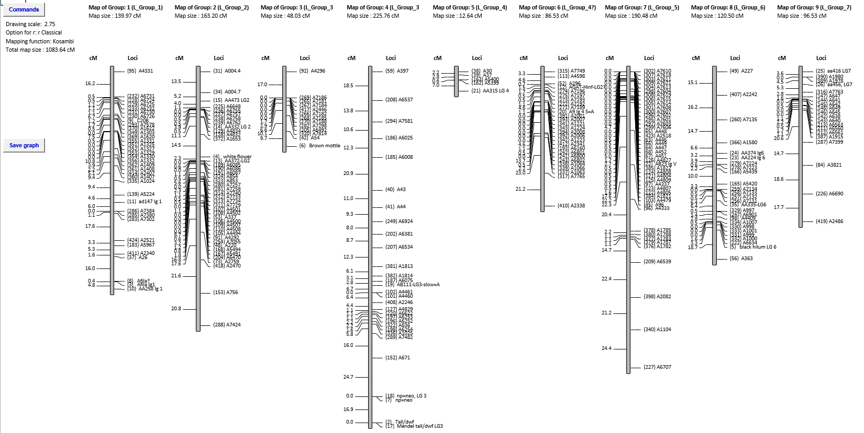
The Linkage Groups: Lodging QTL’s

Slide 9
My Project has two parts
1.2 million data points of genotypic data, most of which is Junk
Genotypic data indicates what allele of a gene has been inherited from which parent.
50,000 data points of phenotypic data
Phenotypic data is generally quantitative data in regards to height, stem width, maturity time, etc.

Slide 10
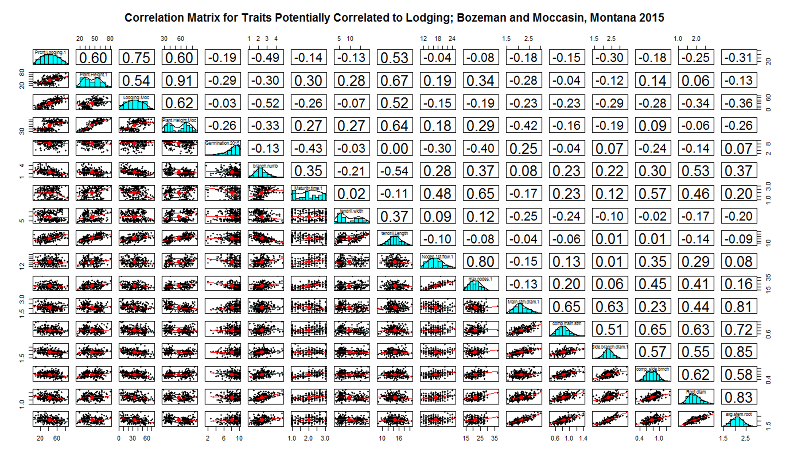
Part 1: The phenotypic data needs to be analyzed to see whether there is a correlation between different traits.

Slide 11
The phenotypic data needs to be paired to the genotypic data in order to discover genes
Lets use an example dataset in map disto.

Slide 13
What I need help with
Finding out what experimental error rate I am willing to accept.
Making a better correlation matrix with r2 values rather than r values.
General analysis of the data and help with QTL mapping
Challenges
I have not yet collected all my data. I really need another month.
Organizing all the data is going to be a big process. There is a lot of it.
I am still unsure what I need to do in regards to statistics.

Slide 14
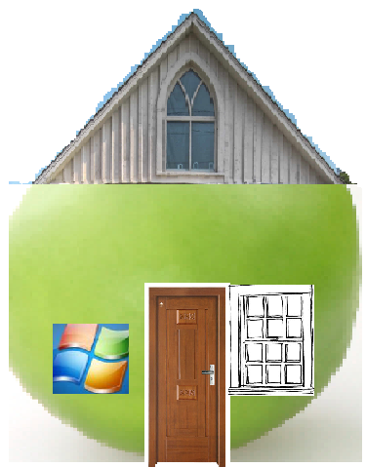
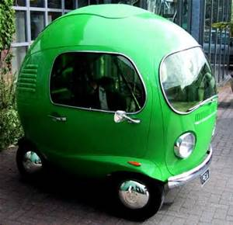
Question: Why can’t everyone Live in Peas. Ans: They are too small.
“Everything comes in time to him who knows how to wait.”
from War and Peas by Leo Tolstoy
“Whenever people ask if I am environmentally conscious. I just tell them that I work for green peas”
“To pea or not to pea. That is the question. Whether tis nobler in the mind to suffer the slings and arrows of outrageous fortune, or to take arms against a sea of troubles and by opposing end them.” From Hamlet by William Shakespeare
“You have to admit that there is a lot at stake here. Like whether peas rise or fall”
Nathaniel Ellis
“You can often find both food and lodging in a field of peas.”
Jamin Smitchger
.
What is my Research Focus in Pea?
Getting an education is not nearly as important as what you do with your education.
Lodging of afila varieties is 31.2875% and 44.3127% for non-Afila varieties
Lodging of dwf varieties is 26.6588 and lodging of tall varieties is 45.9408%
We come in peas
Pea research is really “pulsing” right now. Pea genome will be sequenced within 2 years. Saskatchewan has half of a building dedicated to legume research. Peas are a .5 billion dollar industry in the US and Canada.
Sometimes my mind gets lost in the depths of the viny deep.
We will see whether my theories are vine-dicated.
Do you support green peas greenpeace. I work for green peas
I am kind of a member of the peas corp.
Show a figure of the acreage in peas with Jamin Present vs not present and norm present vs not present.
I am promoting peas on earth.
Ok so now I am going to show you some pictures of lodging. Show a picture of a cool hotel and a lodged field of peas. Need food and lodging, etc.
So many dreams, and so little time to achieve them.
Peas make the world a more peasful place, and who is against world peas.
You can generally find both food and lodging in a pea field.
Don’t forget that we are all people.
I just have a pea brain.
I have been taught to mind my peas and q’s.
Just call me Mendel the 2nd.
An Ode to the Fallen (Over): The Story of Lodging Resistance in Field Pea
Oh for the Love of Pod: Genetic Research to Improve Pisum sativum (Field Pea) in Montana
I quickly decided that I needed some peas and quiet.
I decided to pursue a Peah.D in Plant Genetics focusing on peas, my experience in plant genetics = 0.
Gregor Mendel (1822-1884). May he rest in peas.
Peas make the world a more peasful place, and who is against world peas.
Has anyone heard about the Nobel Peas Prize.

